Slide 1
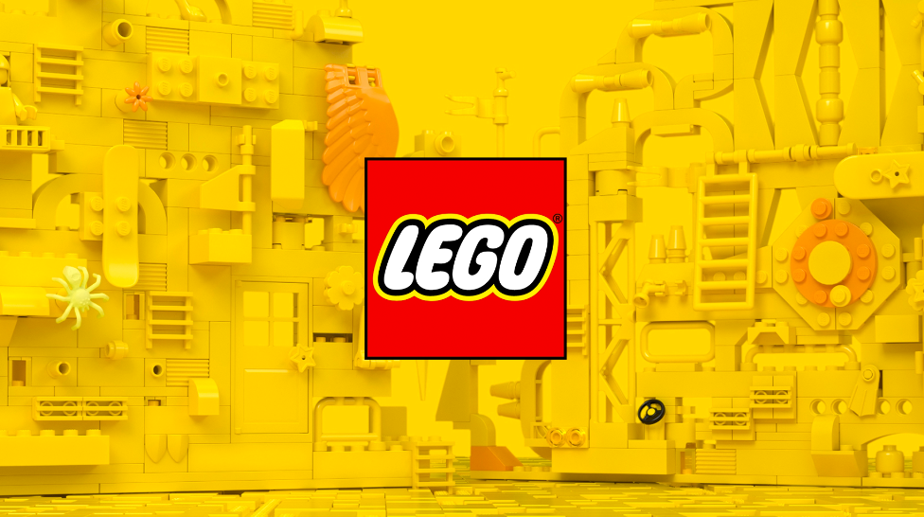
Xiaoyun Chen, Wei Huang, Alicia Ng, Nima Shafikhani,
Andy Wu, Xintong Zheng, Ziqi Zhou

Slide 2
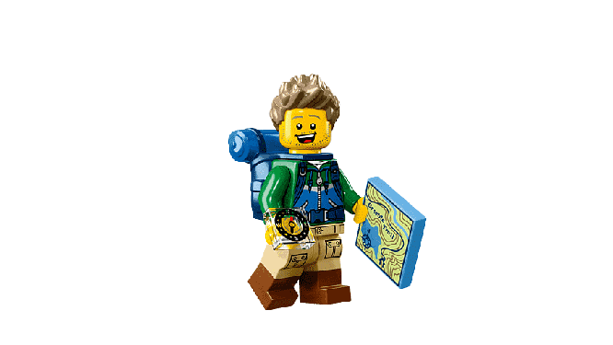
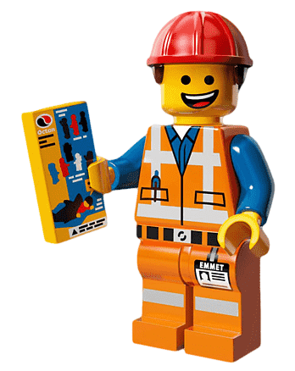

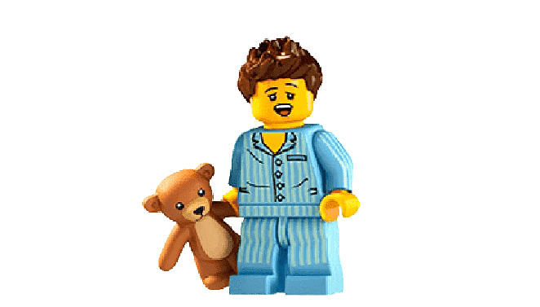
Agenda
01
02
03
04
About
LEGO
Market research
Next steps
Project timeline

Slide 3
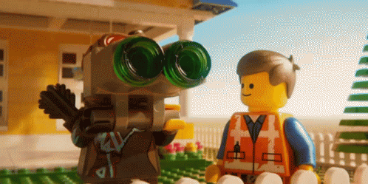
About LEGO
Notes:
Lego is a line of plastic construction toys that are manufactured by The Lego Group, a privately held company based in Billund, Denmark. The company's flagship product, Lego, consists of variously colored interlocking plastic bricks accompanying an array of gears, figurines called minifigures, and various other parts.

Slide 4
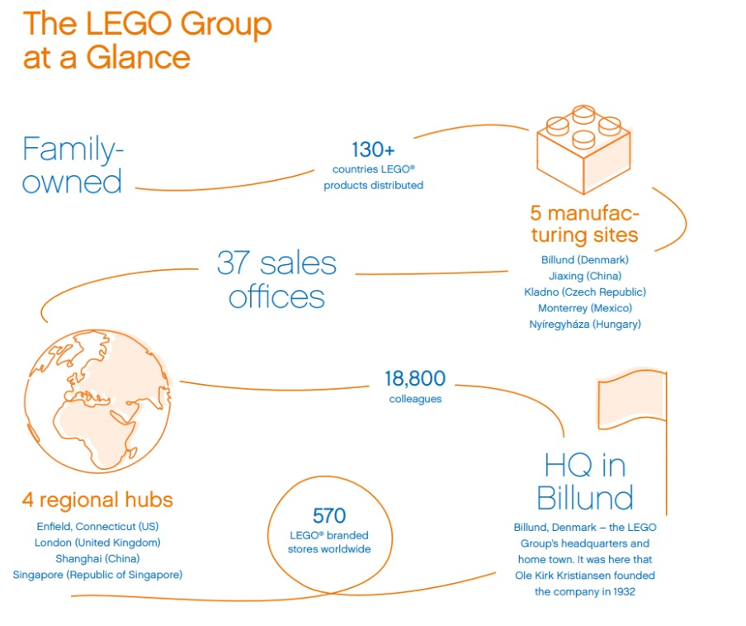
Notes:
Founded in 1932 (Billund, Denmark)
LEGO → two Danish words “leg godt” (“play well”)
LEGO® Group is present in more than 130 countries, owns more than 570 stores and 5 manufacturing plants. Lego invested in its retail ecosystem, partnering with established retail customers to create unique brand moments online and immersive brand experiences in stores.
Innovation is critical to the success of the LEGO® Group and each year new products make up approximately 60% of the portfolio.

Slide 5
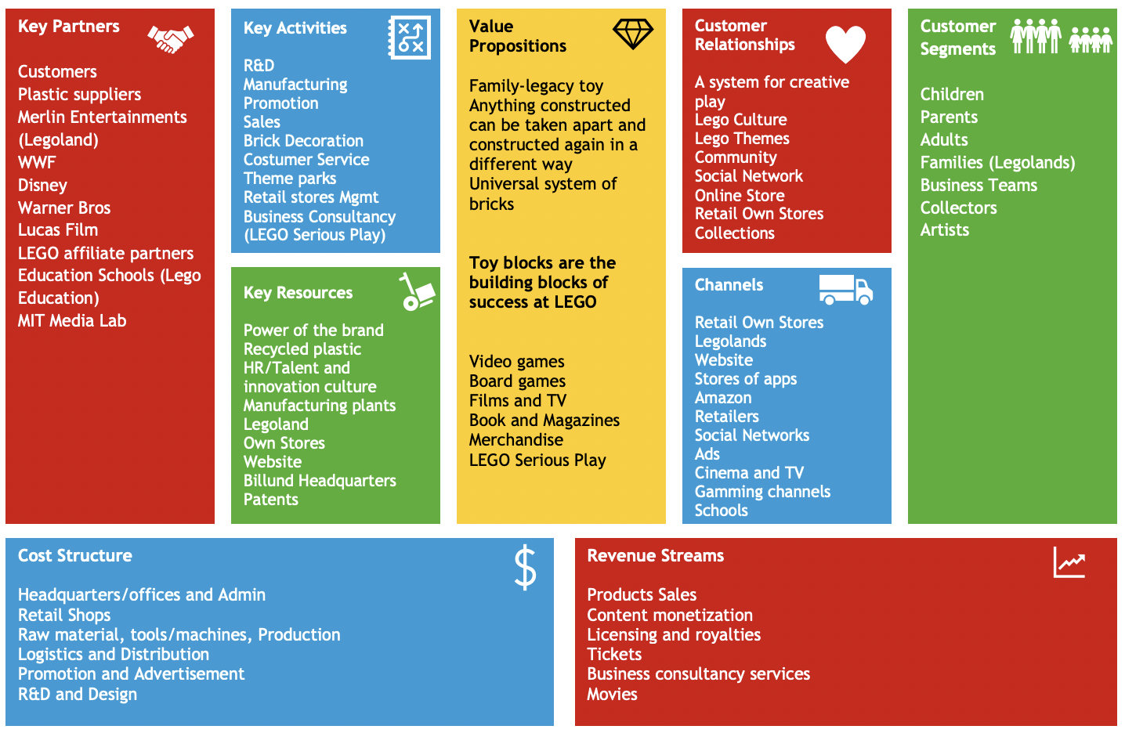
Notes:
https://www.strategosinstitute.com/uploads/cf17cf06ff987718f7a8d8edfb65bc2e6abe59cb33bfd8b079f41b20964e04af.pdf
Page 62
Apart from well-known and successful partnerships originating LEGO® films and LEGO® themes, such as StarWars, Super Mario’s or Marvel, LEGO® also partnered with Merlin Entertainment (world’s second largest visitor attraction operator) to explore Legoland parks.
In 2018, LEGO® founded LEGO® Ventures to invest in the future of learning, creativity, and play. LEGO® Ventures aims to work with entrepreneurs, ideas, and startups centered around playful learning, which includes industries like gaming, adaptive education, and virtual reality.
LEGO® Education have been working with teachers and educational specialists to deliver playful learning experiences that bring subjects to life in the classroom and make learning fun and impactful.

Slide 6
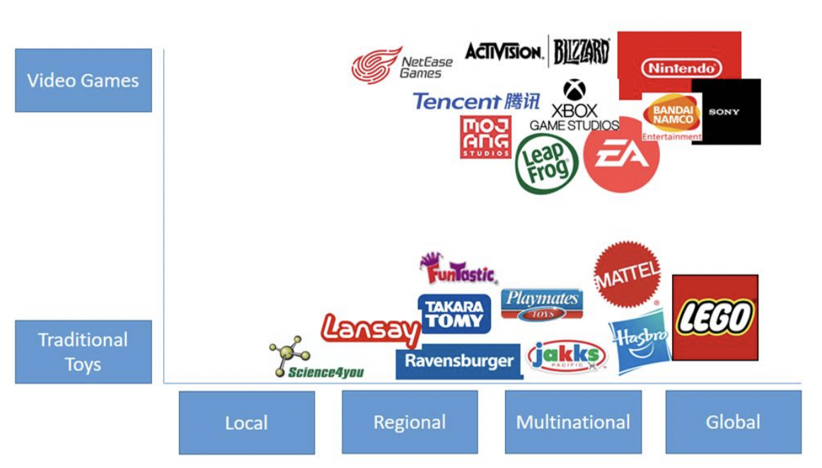
Competitor Analysis
Notes:
https://www.strategosinstitute.com/uploads/cf17cf06ff987718f7a8d8edfb65bc2e6abe59cb33bfd8b079f41b20964e04af.pdf
Next in the report will present further information on LEGO®´s main competitors: Mattel and Hasbro and on Industry top performer Nintendo.
Mattel is an American toy maker brand founded in 1945. First, they started with selling picture frames and after some hard times “the barbie doll” became the cash cow in 1959. Currently present in 40 countries and selling toys in more than 150 countries. North America Remains Mattel´s biggest market.
Hasbro is an American multinational conglomerate with toy, board game and media assets, founded in 1923. Hasbro is enjoying the third position in the toy market, in terms of the stock market revenue with over $5 Bill. Among its products are Transformers, G.I. Joe, Power Rangers, Rom, Micronauts, M.A.S.K., Monopoly, Furby, Nerf, Twister, and My Little Pony
Nintendo is a Japanese multinational consumer electronics and video game company headquartered in Kyoto, founded in 1889. What started with handmade playing cards is now the top player in toy and games industry with a strong brand image, coupled with technological advancements, marketing initiatives as well as industry and licensing partnerships.
https://legositebreakdown.wordpress.com/2015/06/02/lego-competitive-analysis/
https://businesschronicler.com/competitors/lego-competitors-analysis/
https://www.cnbc.com/2018/04/27/lego-marketing-strategy-made-it-world-favorite-toy-brand.html
Hasbro - headquarters in RI, operates in over 40 locations globally. Known for family board game called Monopoly and Transformers. It uses TV to promote its product such as Family Game Night.
Mattel - After The LEGO Group, Mattel is the world’s largest toy manufacturer based on revenue. In 2020, two of Mattel’s most valuable brands, Barbie and Hot Wheels, gained recognition from the NPD Group as the top global toy property and the best-selling global toy of the year.
Spin Master - Canadian multinational entertainment headquartered in Toronto. Notable brands include Bakugan and Rubiks Cube. It has been nominated for more than 90 “toy of the year”
Bandai Namco - headquarters are in Tokyo, known for videogame franchises such as Pac-Man

Slide 7
Go to market
Diversification of products
A wide range of prices
Collaboration with major brands
Various distribution channels
Customer services
Notes:
https://planetmedia.com.au/blog/marketing-strategies-of-lego/
https://www.brand-experts.com/brand-strategy/brand-experience/

Slide 8

Botanical Collection
Notes:
https://www.goodnet.org/articles/legos-unveils-new-botanical-builds-for-adults
https://www.justsaying.asia/lego-launches-botanical-collection-to-bring-zen-into-your-home-this-new-year/
https://bunnygaming.com/collectibles/new-lego-botanical-collection/

Slide 9
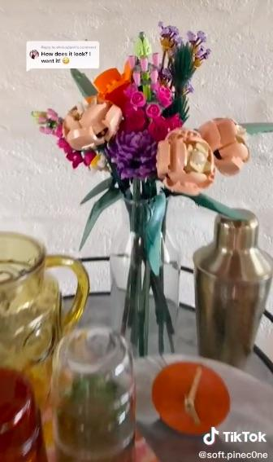
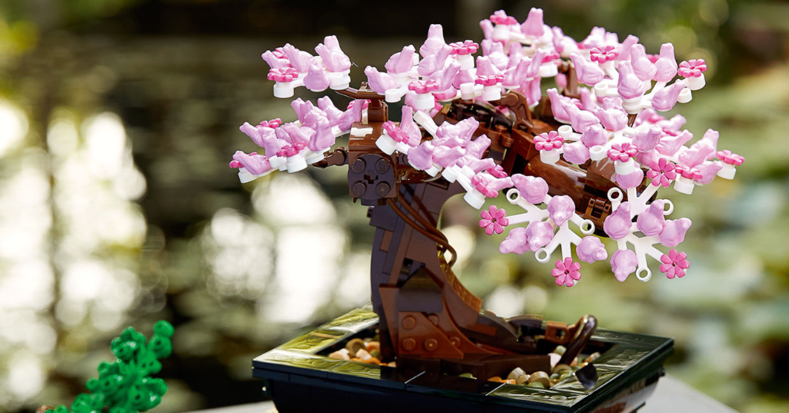
Released on January 1, 2021
Flower Bouquet + LEGO Bonsai Tree
Great for interior design of any home
Great for de-stress and mindfulness
“73 percent of adults are actively looking for ways to destress and that 81 percent of adults said that playing helps them relax.”
– Press Release (LEGO Group), December 2020

Slide 10
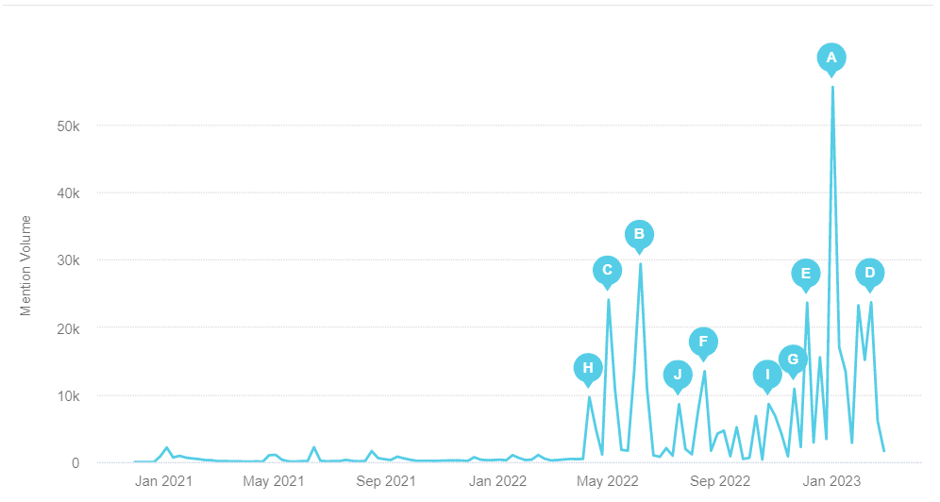
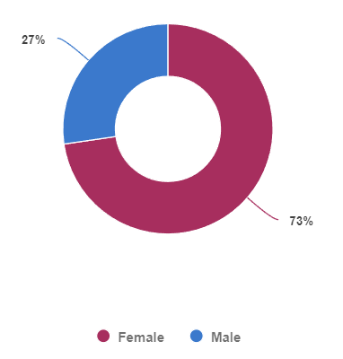
Botanical Garden - BrandWatch Results
Mention Volume Over Time
27%
Male
Knockoff
(Valentine’s Day)
(3M Reach)
Knockoff
(18M Reach)
Knockoff
(11M Reach)
73%
Female

Slide 11
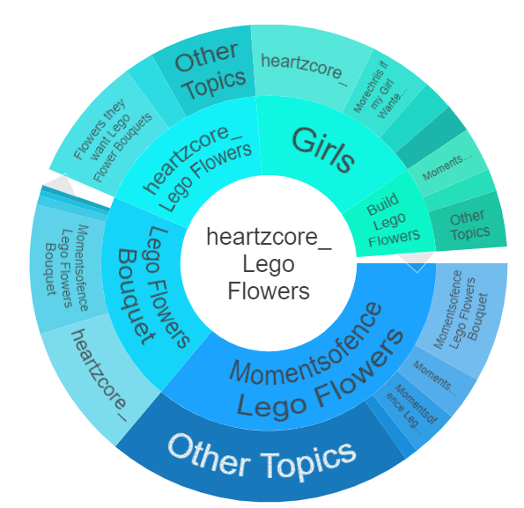
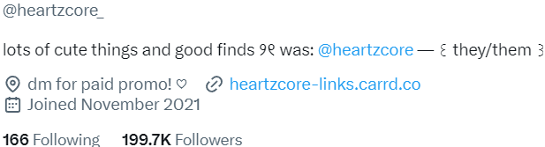
Botanical Garden - BrandWatch Results
Account centered around posting aesthetics and products that cater to young women (millennials, Gen-Z)
Responsible for the drivers of 2 of the 3 biggest peaks
Posts LEGO Botanical knockoffs

Slide 12

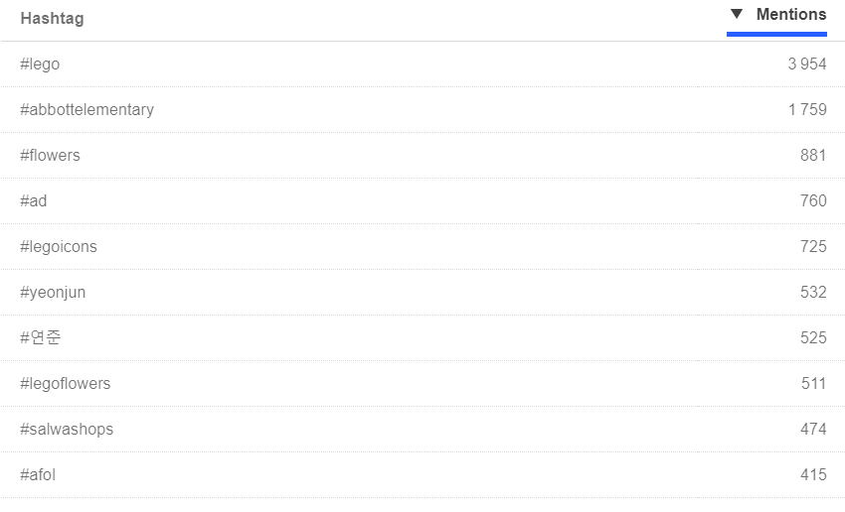

Botanical Garden - BrandWatch Results
Abbott Elementary
(TV Show) -
Featured Botanical Set
Yeonjun
(K-Pop Star) -
Reacted to fan giving him Botanical Set as a gift

Slide 13
SWOT ANALYSIS
Strength:
Noticeable exposure through other brands (TV show, celebrity)
Positive reaction towards concept of inanimate, buildable flowers
Weakness:
Not connected with low affinity audience (Millennial/Gen-Z women) that have shown interest in a very similar product
S
W
Opportunity:
Millenial/Gen-Z women
Festival Limited (Valentine’s Day)
Attach to a brand (show, influencer, etc.)
Threat:
Discussion linked to another brand (knock-offs using LEGO name)
O
T

Slide 14
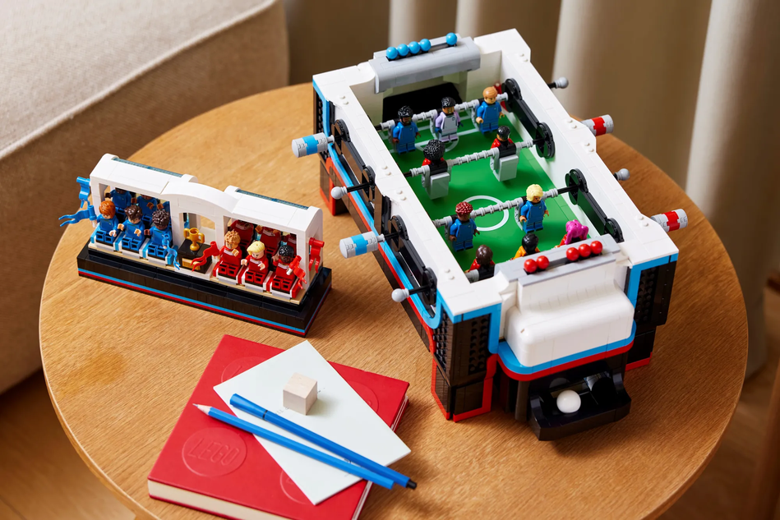
Mini Football
Notes:
http://thebrickblogger.com/2022/11/brick-breakdown-lego-ideas-table-football/
https://www.thebrickfan.com/lego-ideas-table-football-21337-officially-announced/#:~:text=The%20LEGO%20Ideas%20Table%20Football,skin%20tones%20to%20choose%20from.

Slide 15
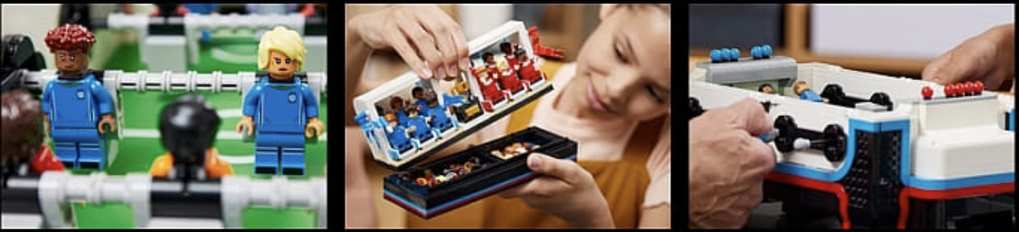
Released on November 1, 2022
Honours football players and fans from around the globe
22 diverse minifigures - 44 choices for heads in 4 skin colors
For football/soccer enthusiasts
“Throughout my career I’ve played football everywhere you can imagine. I am very excited to see the new LEGO set bring people together across the world as they master the table football game in brick form.” – Thierry Henry (World Cup Winner)

Slide 16
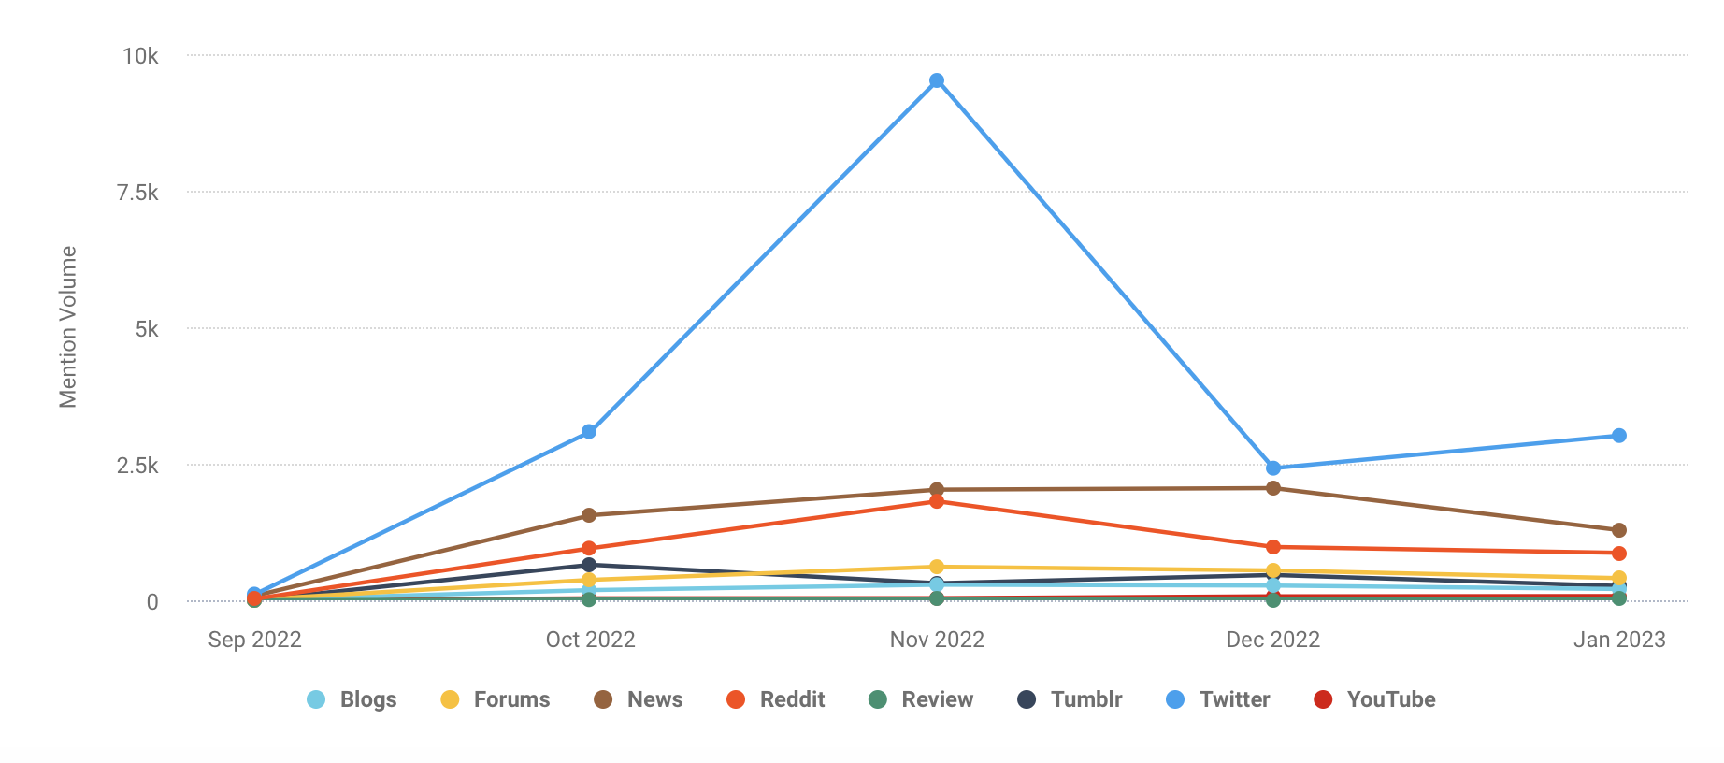
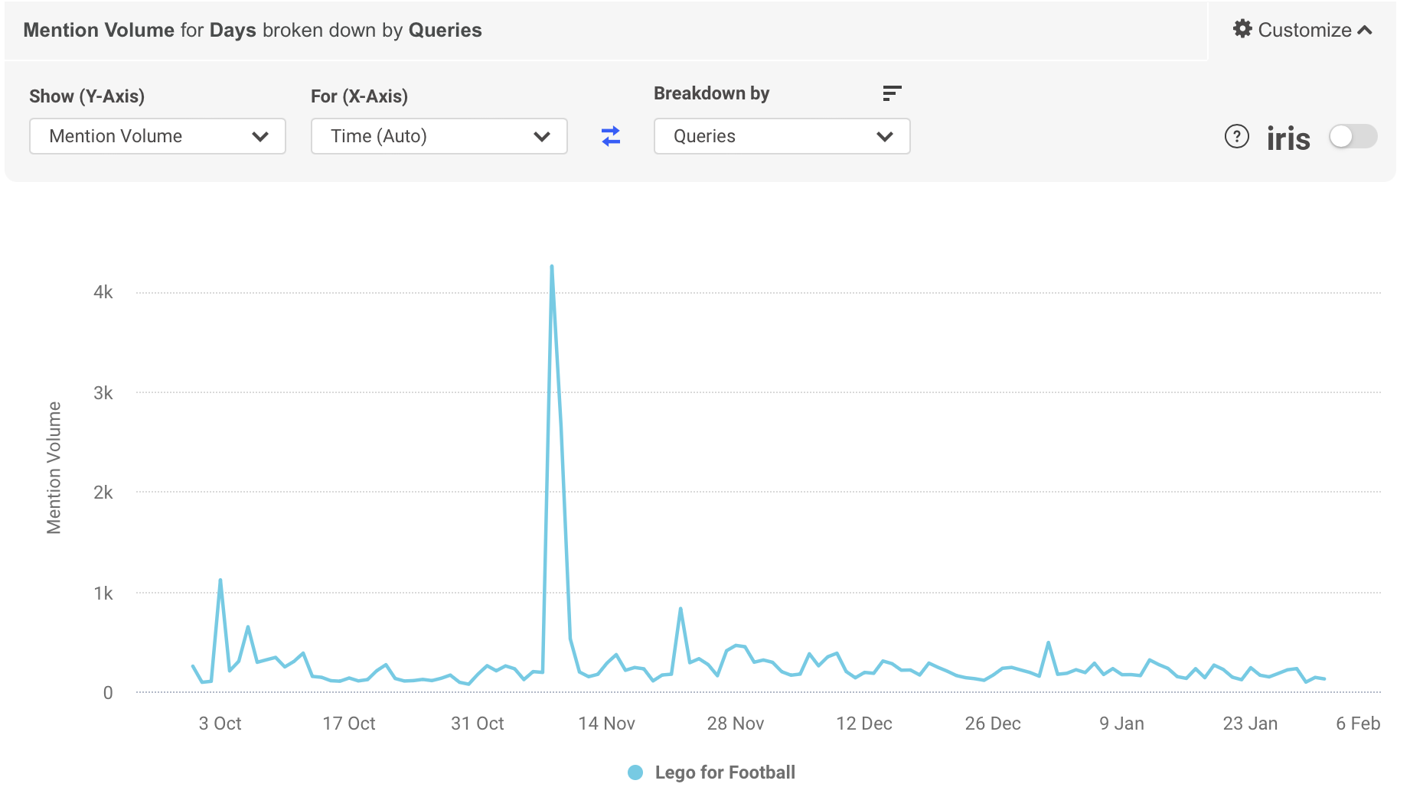
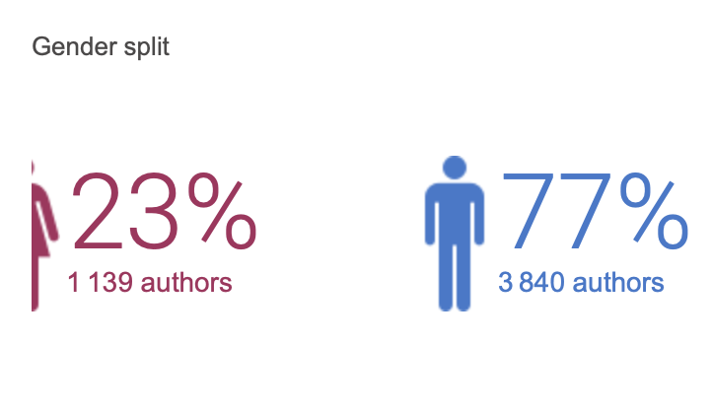
Mini Football - BrandWatch Results
Qatar Stadium
Notes:
Lego see the Mini Football campaign is weak.
The highest mentioned about Lego football is not talking about the real Lego product. But the Stadium 974 in Qatar which can be completely dismantled, transported to another country and put back together like Lego.
Can compare the number of mentioned volume with other campaign.
The gender percentage can compare with the lego flower’s statistic.
Lego also made lots of video about the football. But it seems that the outcome is not well.

Slide 17



Cross Platform Analysis
Age Group: 18-24 (21.5%)
25-34 (30%)
@LEGO @LEGO Marvel Video Game
Groups on Facebook:
LEGO Technic. - 214k members
LEGO WANTED buy, sell, trade - 139k members
LEGO - Biggest Fans - 112k members
Age Group: 18-24 (30.1%)
25-34 (31.5%)
@LEGO @brickcentral
Hashtags on Instagram:
#LEGOstagram - 2.59m posts
#LEGOminifigures - 2.74m posts
#afol - 2.79m posts
Age Group: 18-29 (50%)
30-49 (27%)
Subreddit:
r/LEGO - 1.3 million subscribers
r/LEGOstarwars - 350,000 subscribers
r/AFOL - 50,000 subscribers
r/LEGOtechnic - 45,000 subscribers
r/LEGOMarket - 40,000 subscribers

Slide 18
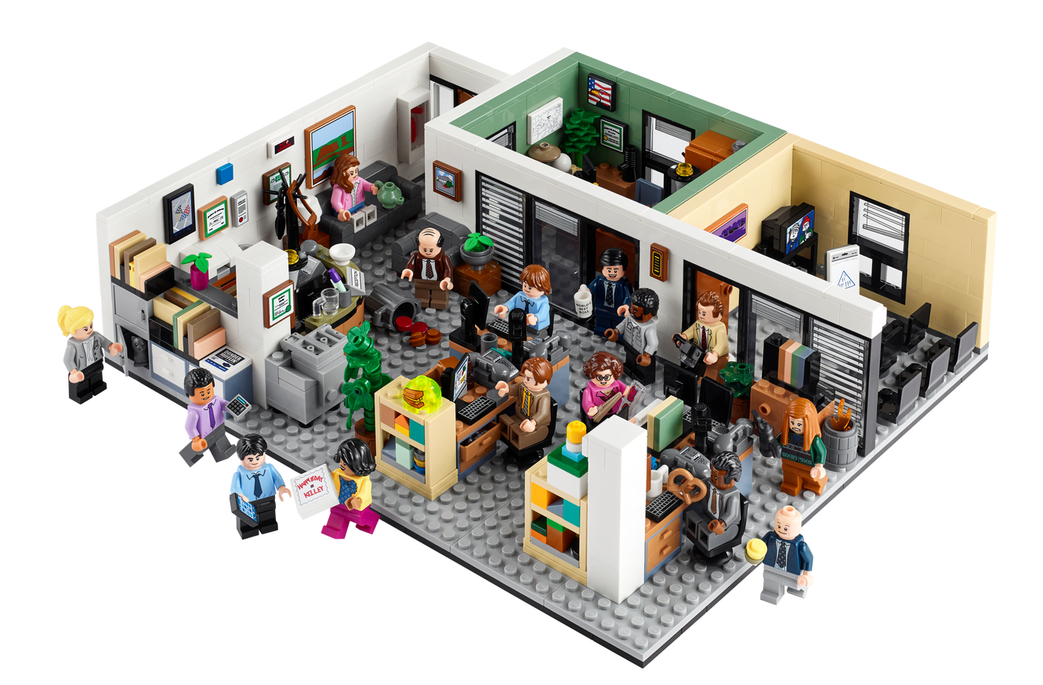
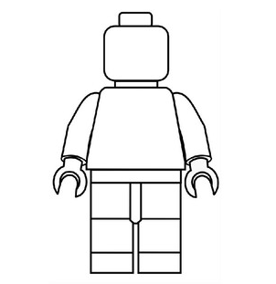
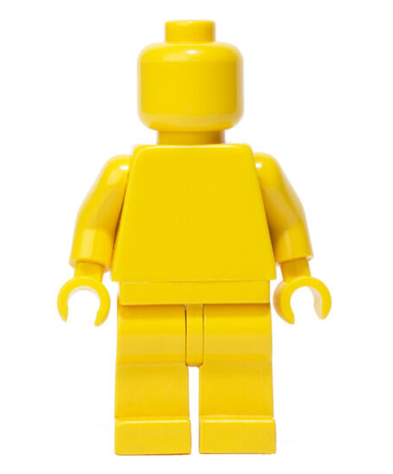
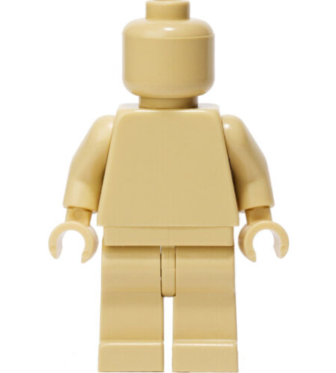
03
Project schedule
From Bricks to Sets
From Ideas to Campaigns
Notes:
https://www.teacherspayteachers.com/Product/Create-YOUR-own-Characters-Lego-Figure-Super-Hero-Portrait-SUB-Lesson-4766665?gclid=Cj0KCQiAo-yfBhD_ARIsANr56g7pG-NJFvPaZvHuakWnP94hLNgIlQSMzyyOJ1TG_WP_GU-eG16mgUgaAg1CEALw_wcB
https://www.ebay.com/itm/124750543183?chn=ps&norover=1&mkevt=1&mkrid=711-117182-37290-0&mkcid=2&mkscid=101&itemid=124750543183&targetid=1263104805766&device=c&mktype=&googleloc=9005929&poi=&campaignid=14859008593&mkgroupid=130497710760&rlsatarget=pla-1263104805766&abcId=9300678&merchantid=114833312&gclid=Cj0KCQiAo-yfBhD_ARIsANr56g6GrnwEoQ8QhWBiDCHgiEt9rmNbe8Pddu9lfs5GjWBXwMAV-oyQ7IgaAjULEALw_wcB
https://www.amazon.com/LEGO-Collectible-Minifigure-17-71018/dp/B0722GYV3R/ref=asc_df_B0722GYV3R/?tag=hyprod-20&linkCode=df0&hvadid=309875729163&hvpos=&hvnetw=g&hvrand=16360399408247256083&hvpone=&hvptwo=&hvqmt=&hvdev=c&hvdvcmdl=&hvlocint=&hvlocphy=9005929&hvtargid=pla-554762141401&psc=1&tag=&ref=&adgrpid=65715448310&hvpone=&hvptwo=&hvadid=309875729163&hvpos=&hvnetw=g&hvrand=16360399408247256083&hvqmt=&hvdev=c&hvdvcmdl=&hvlocint=&hvlocphy=9005929&hvtargid=pla-554762141401

Slide 19
Our approach
Phase 1
Phase 3
Project Details
Brandwatch Access
Campaign Detail
Predictive Analysis
Define Campaign Features
Business Analysis
Phase 2
Phase 4
Data Wrangling
Data Analysis
Strategy Planning
Competitor Analysis
Assessment Tool Building
Model Interpretation
Business Intelligence

Slide 20
Project schedule
 |  |  |  | Feb 01 - Feb 15 |  |  |  | Feb 16 - Mar 01 |  |  |  | Mar 16- Apr 12 |  |  |  | Apr 13 - Apr 25
Phase 1-2 |  |  |  | Project Overview |  |  |  | Grand Strategy and Data Analysis
Business Team |  |  |  | Project Details |  |  |  | Position,Competitor
Tech Team |  |  |  | Brandwatch Access |  |  |  | Queries, analysis
Phase 3-4 |  |  |  |  |  |  |  |  |  |  | Business Analysis |  |  |  |  | Further Adjustment
Business Team |  |  |  |  |  |  |  |  |  |  | Model Interpretation |  |  |  | Refine key indicators
Tech Team |  |  |  |  |  |  |  |  |  |  | Model Building |  |  |  | Optimize model precision

Slide 21
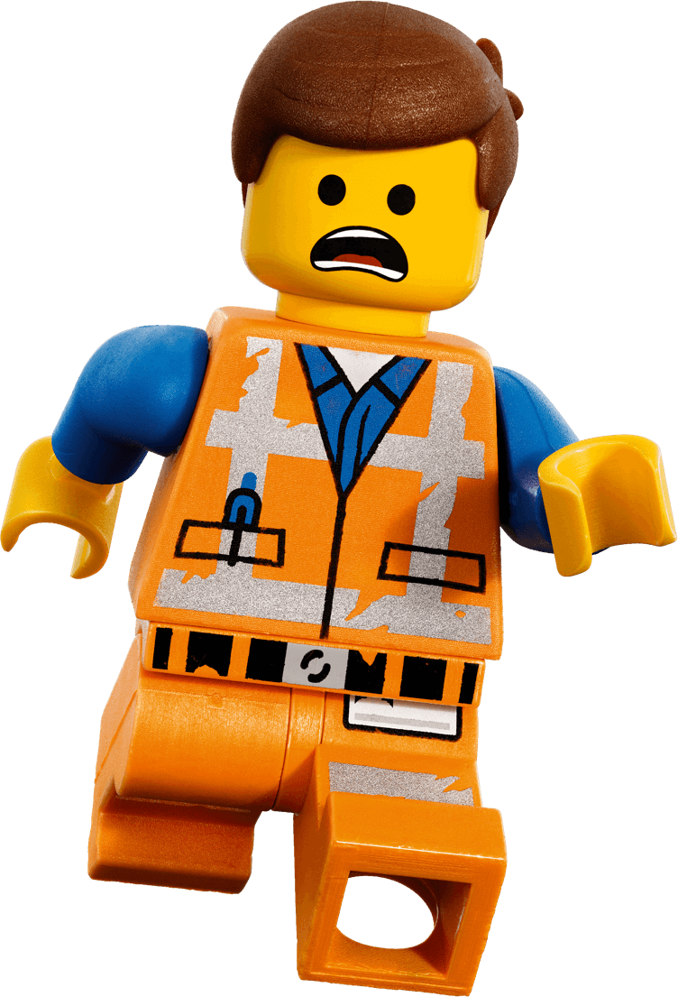
Risk and Mitigation
Logistics & Overall risks
Failing to better understanding of the business objectives
Data Analysis Knowledge Gap
Potential inefficiency of a large team
Tactics: Better Communication, External Source of Help
Model Specific
Metrics Selection
Inaccurate Sentiment Analysis Labels
Noise Alleviation
Tactics: Manual Elimination of Noise, Complementary Qualitative Analysis
Notes:
https://www.lego.com/en-us/eng/info/default.asp?page=press

Slide 22


